Slide 1
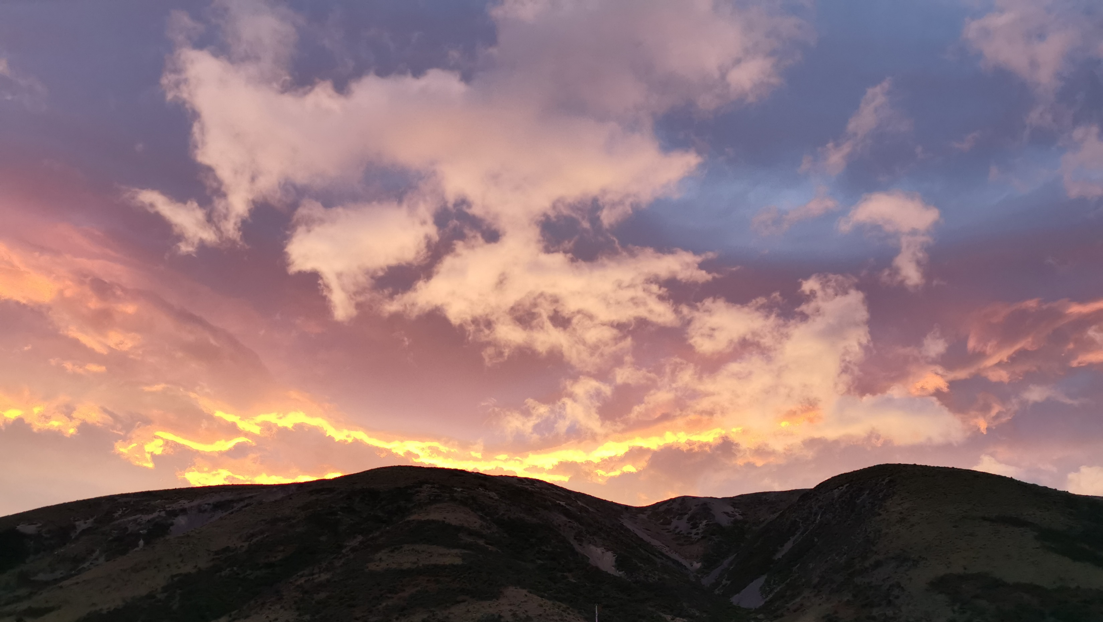
BUSINESS NAME
Proposed restructure
Company confidential
MONTH 2020

Slide 2
privileged & confidential
The information contained in this document is confidential, privileged and only for the information of the intended recipient(s) and may not be used, published or redistributed without the prior written consent of the document owner.
Distribution without written consent may result in the termination of your employment.
Commercial & confidential
2

Slide 3
contents
executive summary
proposed change
who will be impacted
timeline
Commercial & confidential
3 of XX

Slide 4
executive summary & proposed change
The global outbreak of Covid-19 is having a significant impact on businesses worldwide. Our business has sufferd a significant loss of business and, despite governmentassistance, it is no longer viable to maintain operations. Our view is that the downturn which is likely to continue throughout our winter will have financial implications that are ongoing into the foreseeable future.
USE WHAT IS RELEVANT AND ADAPT AS NEEDED
We have discussed options with the team that include reduced hours / days but having considered these options, we realised that this would not be enough to ensure viability going forward. (delete if not occurred)
We propose to reduce the headcount in our office by NN people to lower overhead costs and reduce the number of consultants sharing the reduced amount of available work This will require that all consulting roles are disestablished and staff will need to apply for the reduced number of roles To be fair to all, we have elected not to differentiate between full-time and part-time roles (it is possible that hours will be reviewed for remaining staff as the full impact of the virus occurs in coming months). We propose to conduct structured interviews based on the position description and the ability to adapt to the changed environment (while we work closely and have regular feedback, this is the fairest and most reasonable approach to selecting who will be appointed to the remaining roles). (OR we propose to make the people most recently appointed redundant as this seems the fairest approach).
/ OR
We propose to close our office until we can viably begin operating again. This would mean all roles are disestablished and all staff would be made redundant.
While our wish has been to continue to continue operating, we can see no way to achieve this and welcome your feedback on this proposal.
Commercial & confidential
4

Slide 5
who will be impacted?
Key stakeholder | How? | Level
STAFF NAMES | Role disestablished Can apply for one of remaining roles if relevant | High
Commercial & confidential
5

Slide 6
timelines / next steps
Step | Due | Reminder
Present proposed changes to team | DATE
Feedback on proposed changes due | DATE
Decision on proposed changes | DATE
Start implementation of any changes | DATE
The information contained in this document is confidential, privileged and only for the information of the intended recipient(s)
and may not be used, published or redistributed without the prior written consent of the document owner.
Distribution without written consent may result in the termination of your employment.
Feedback should be sent to me via email (DATE)
NAME
commercial & confidential
6

